Slide 1
Microsoft Student Starter Pack
Speaker: Kenji Phang
Notes:
Hi everyone, welcome to the first student ambassador and student in person meetup event, its nice to see people out on a Tuesday evening, we only have 20 minutes so without further ado, lets begin the talk

Slide 2

Kenji.Info
Beta Microsoft Learn Ambassador
CS Student from the University of Manchester
Doing a placement as a Fullstack Engineer at Interact Software
Interests: .NET and Azure
Notes:
Let me first introduce myself, I’m Kenji, a Microsoft learn student ambassador, I’m studying computer science at the university of Manchester and I’m currently doing my placement as a fullstack engineer at Interact software.
Now, I sound like I have a few things under my belt, but to be honest, just one year ago, I was just an average university student and I wasn’t doing anything more than what was necessary to pass my first year. I knew that I wanted to pursue a career in technology but I wasn’t even sure where to start, I did some research on the space here and there, watched those day in the life videos but I was still lost and I had to spend a lot of time figuring out what to do

Slide 3
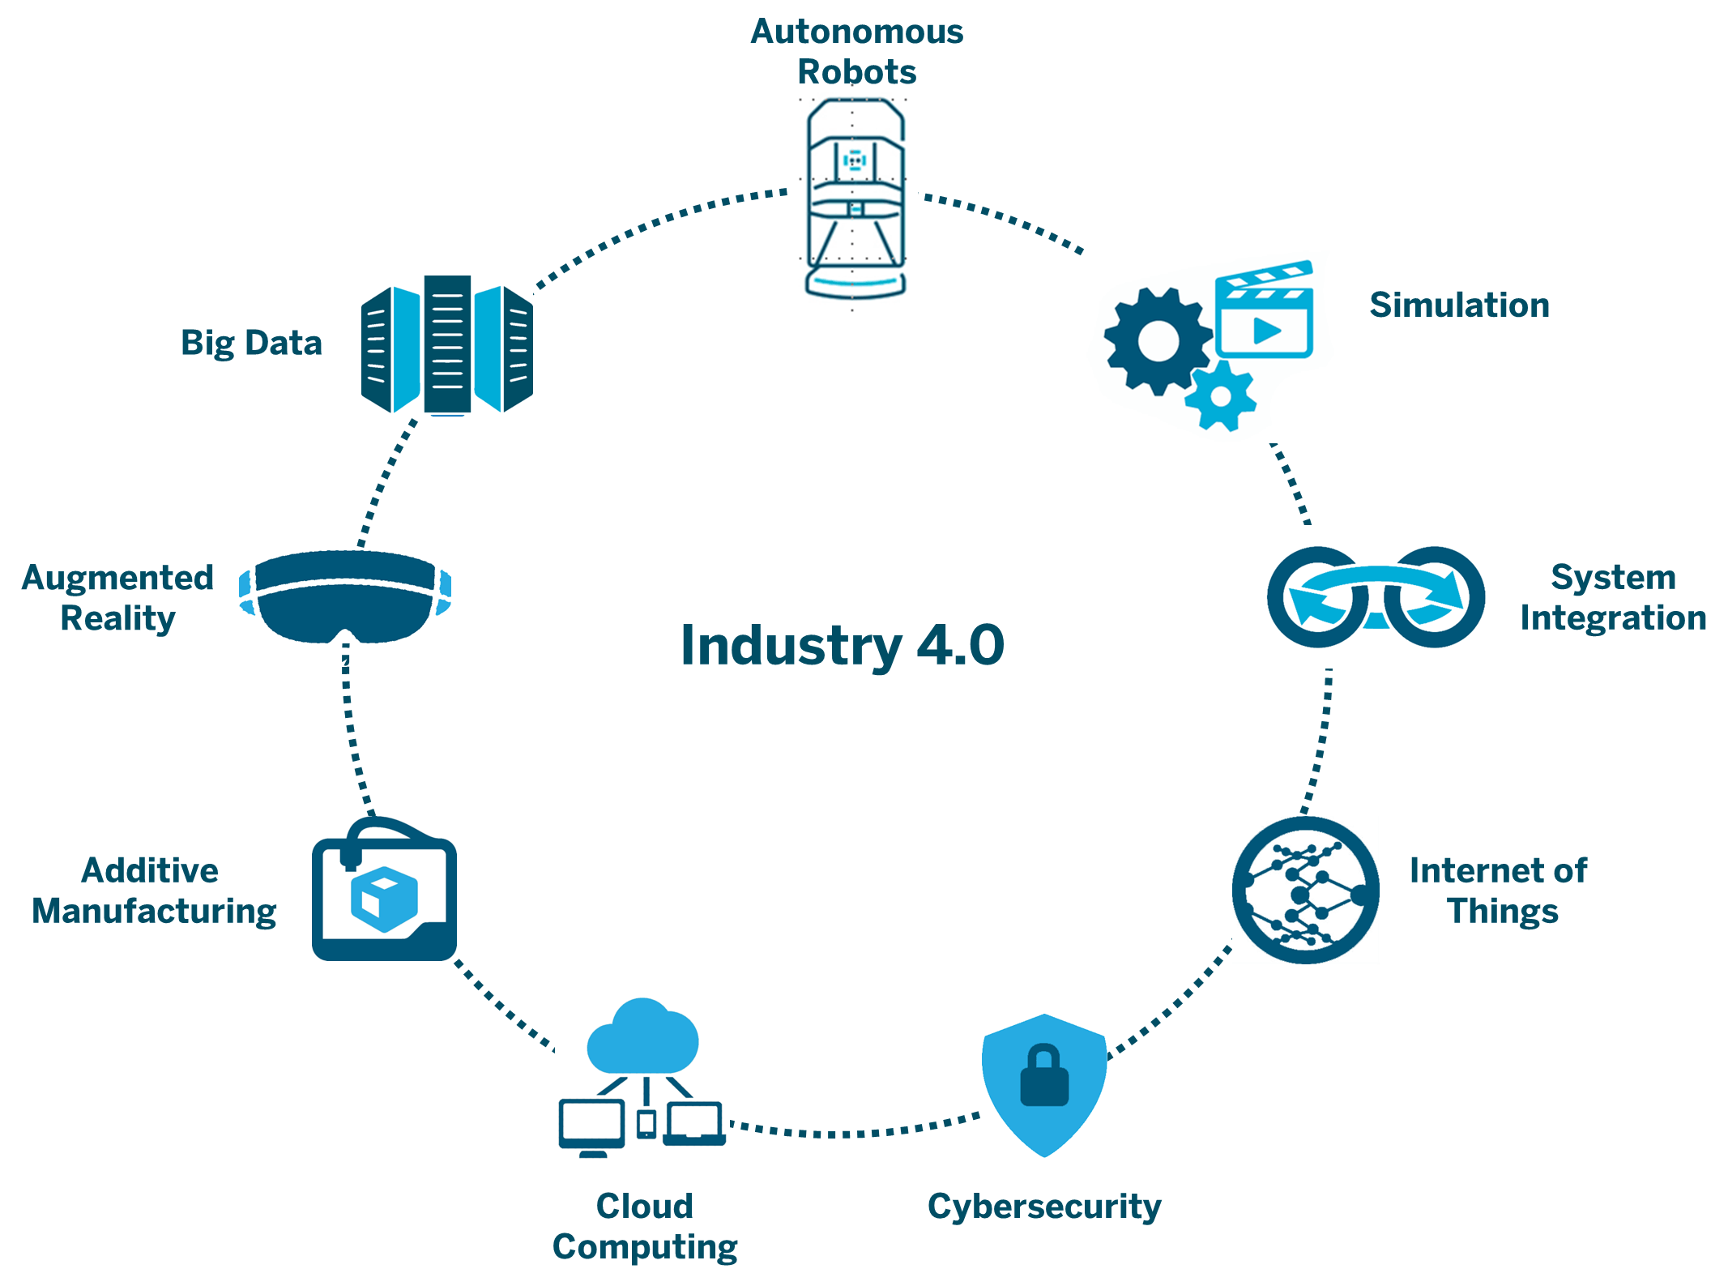
Technology is overwhelming
Notes:
Let’s just dive straight to the problem here, that is technology is just so overwhelming. A career in tech is very flexible, you can get into pretty much any industry with a STEM degree, every industry needs technology right? As you can see, as we are heading into industry 4.0, there are tons of options to pursue. But the tradeoff is that there are just so many options and choices to consider, at some point, you might be asking yourself:
How do I find out which field is right for me?
Which fields should I try out first?
When you picked something, you wonder, what is it like on the other side, is this right for me?
Should I try something else, but I already invested so much time in this one thing? Is it worth it?
Do I even have time to try everything?

Slide 4
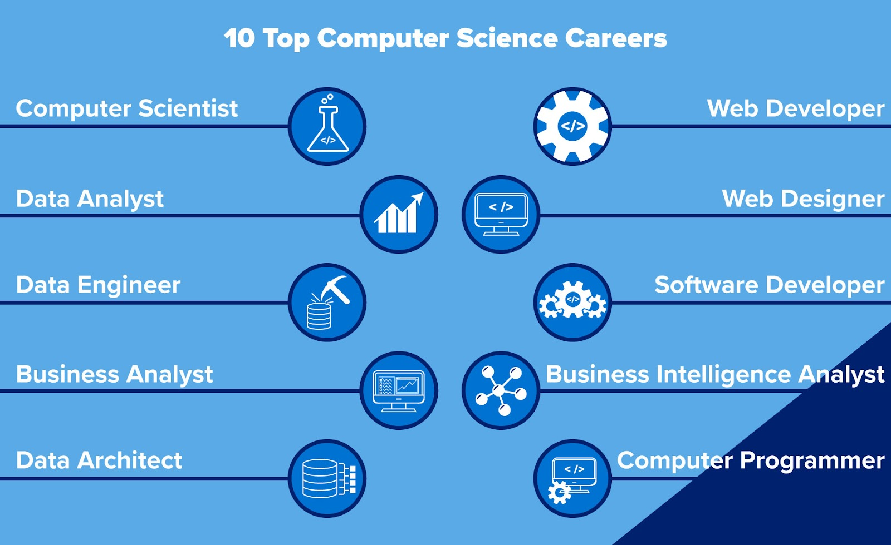
Job roles are overwhelming
Notes:
And its not just that, here is another consideration. What role is right for me? Do I want to be a developer? A data analyst? The worst feeling is when you don’t even know that the role exists? I didn’t know what a cloud architects is until I joined the ambassadors programme

Slide 5
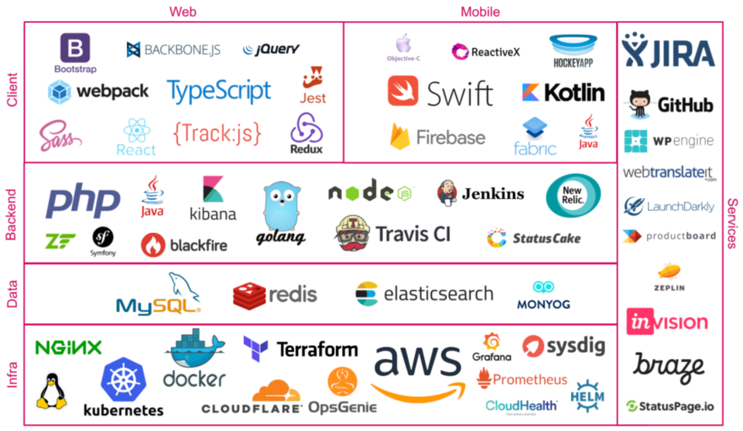
Tech stacks are overwhelming
Notes:
Even after you’ve have decided the field or role, you are still bombarded with the options for the tools. Here are a bunch of tools that can be used to do the same thing, good luck choosing which to learn?

Slide 6
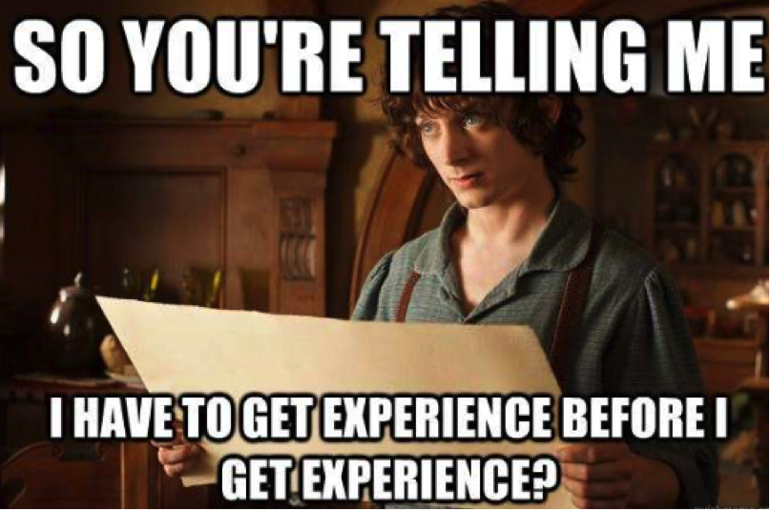
How do I get hired?
Notes:
And that’s not all, you still have to think about how you can get the job itself, you have to be competitive, you need to find ways to make you and your CV stand out. If you are a student looking for internships, you have to somehow figure this out even earlier, but it is hard to make a move because of the choice paralysis

Slide 7
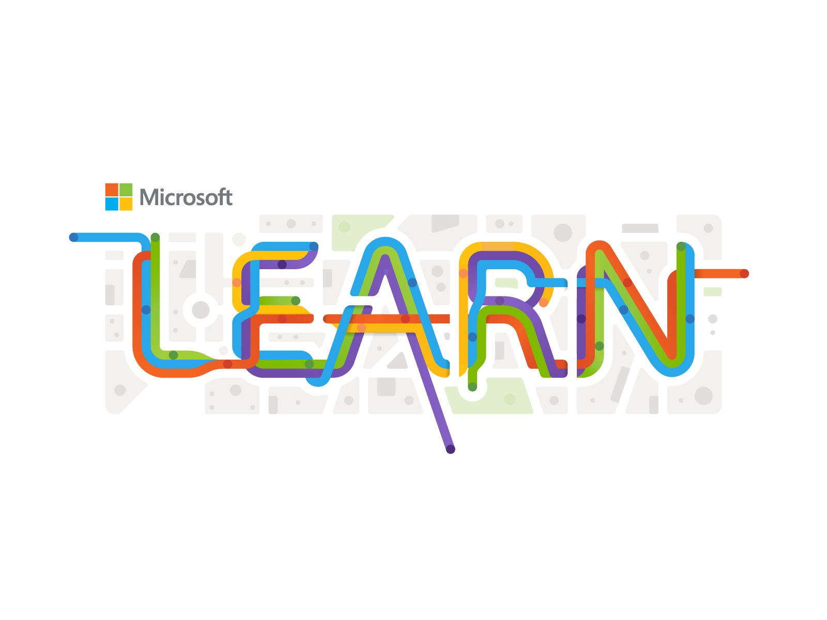






The (unofficial) Microsoft Student Starter Pack
Notes:
I went through all of that myself and let me tell you, its not enjoyable. To save you all some time and sanity, I want to share with you all what I call the Microsoft student starter pack. This pack basically consists of the tools, resources and student opportunities you can take advantage of from Microsoft and its subsidiary companies. And I also want to share about how you can use them to make yourself stand out.
If you are new to the path of technology, feel free to use this as a starting point and if you have already been doing some stuff, here are some things that can enhance and accelerate your developer journey.

Slide 8
Basics Things to know
Notes:
There are a lot of things to cover so let’s look at the basics first

Slide 9
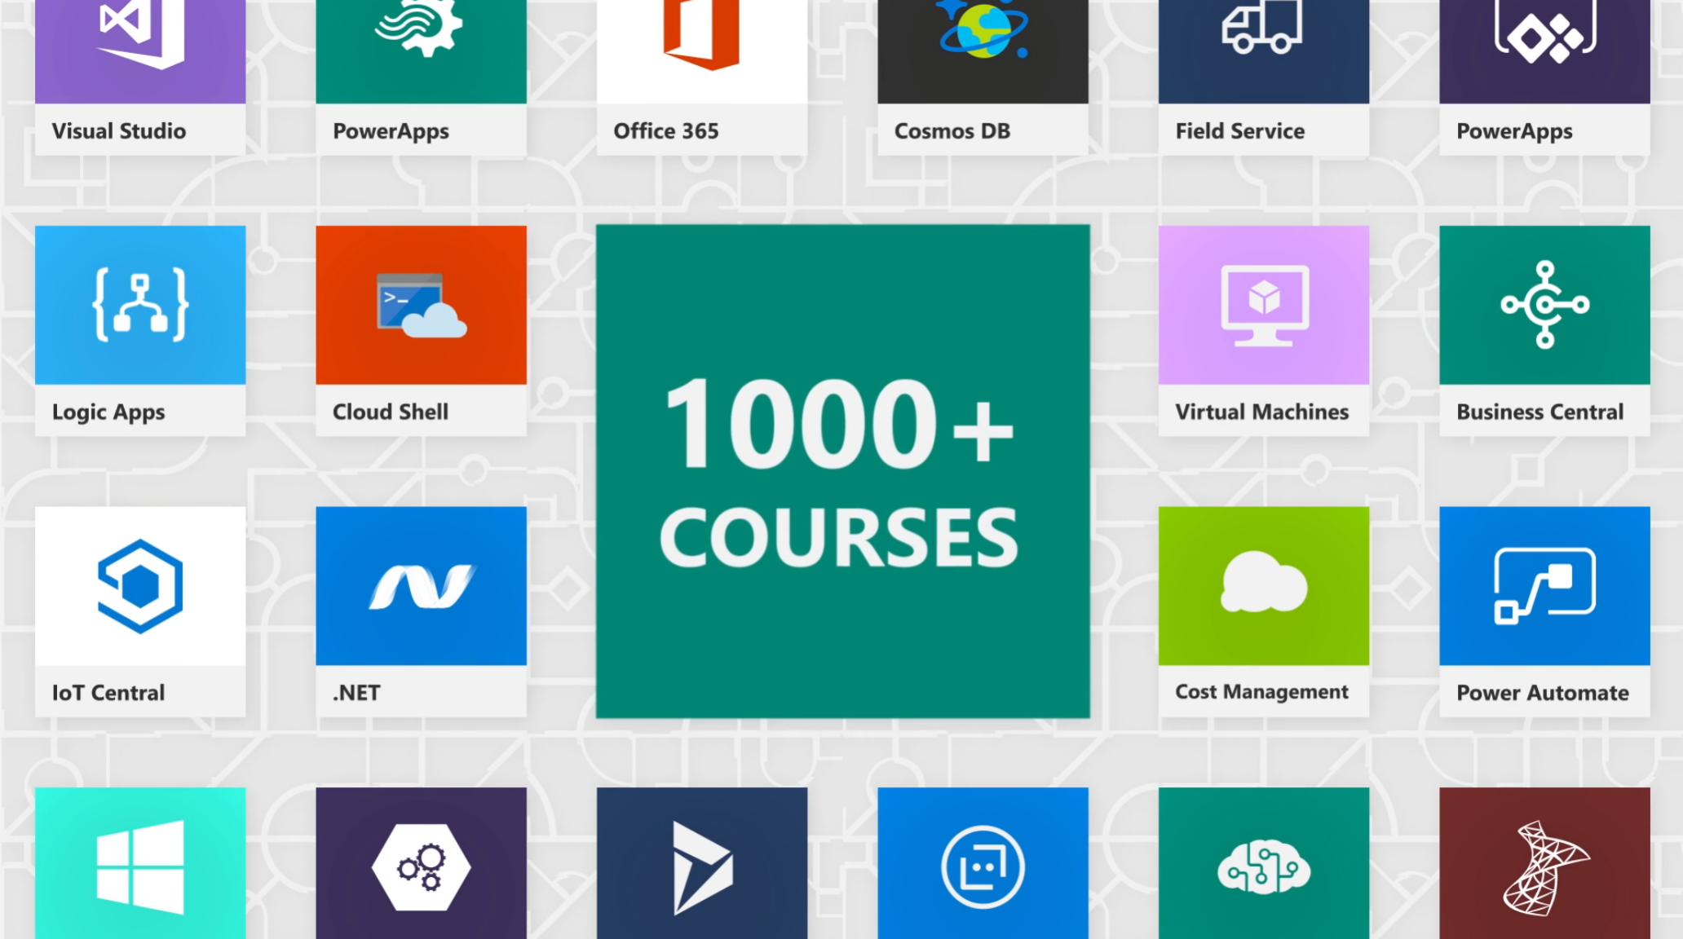
Microsoft Learn
Notes:
The first thing we will look at is Microsoft Learn. As the name suggests, its Microsoft’s own learning platform where you can learn a variety of topics from general stuff like cloud computing and software engineering to niche stuff like mixed reality and quantum computing.
https://docs.microsoft.com/en-us/shows/one-dev-minute/what-is-microsoft-learn

Slide 10
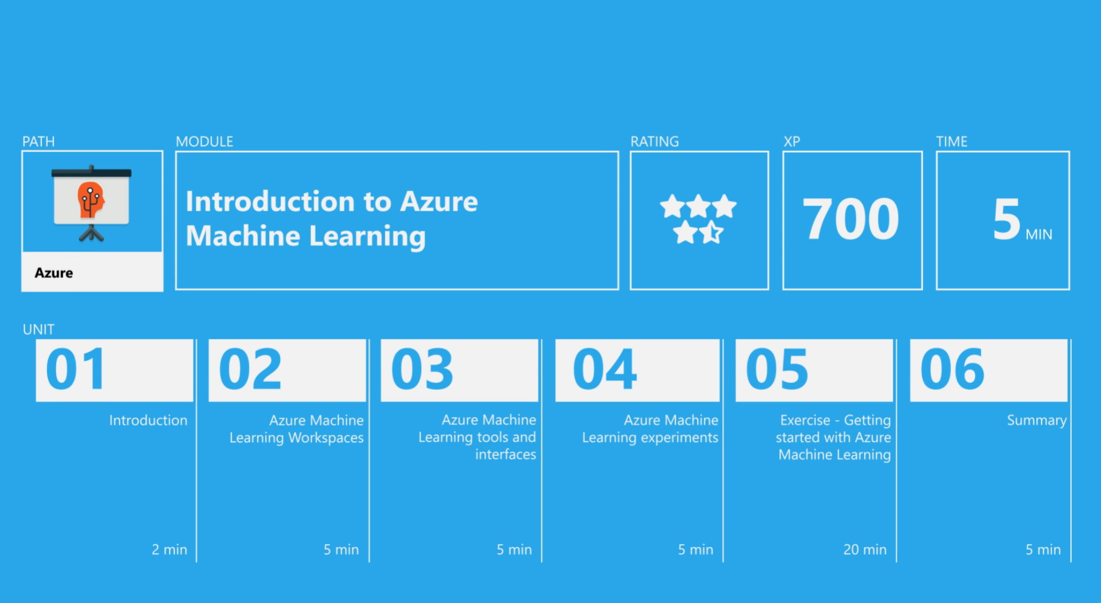
Microsoft Learn
Notes:
The content here is taught through modules, which usually takes around an hour long each, and there is a knowledge test at the end of each module to reinforce the knowledge.

Slide 11
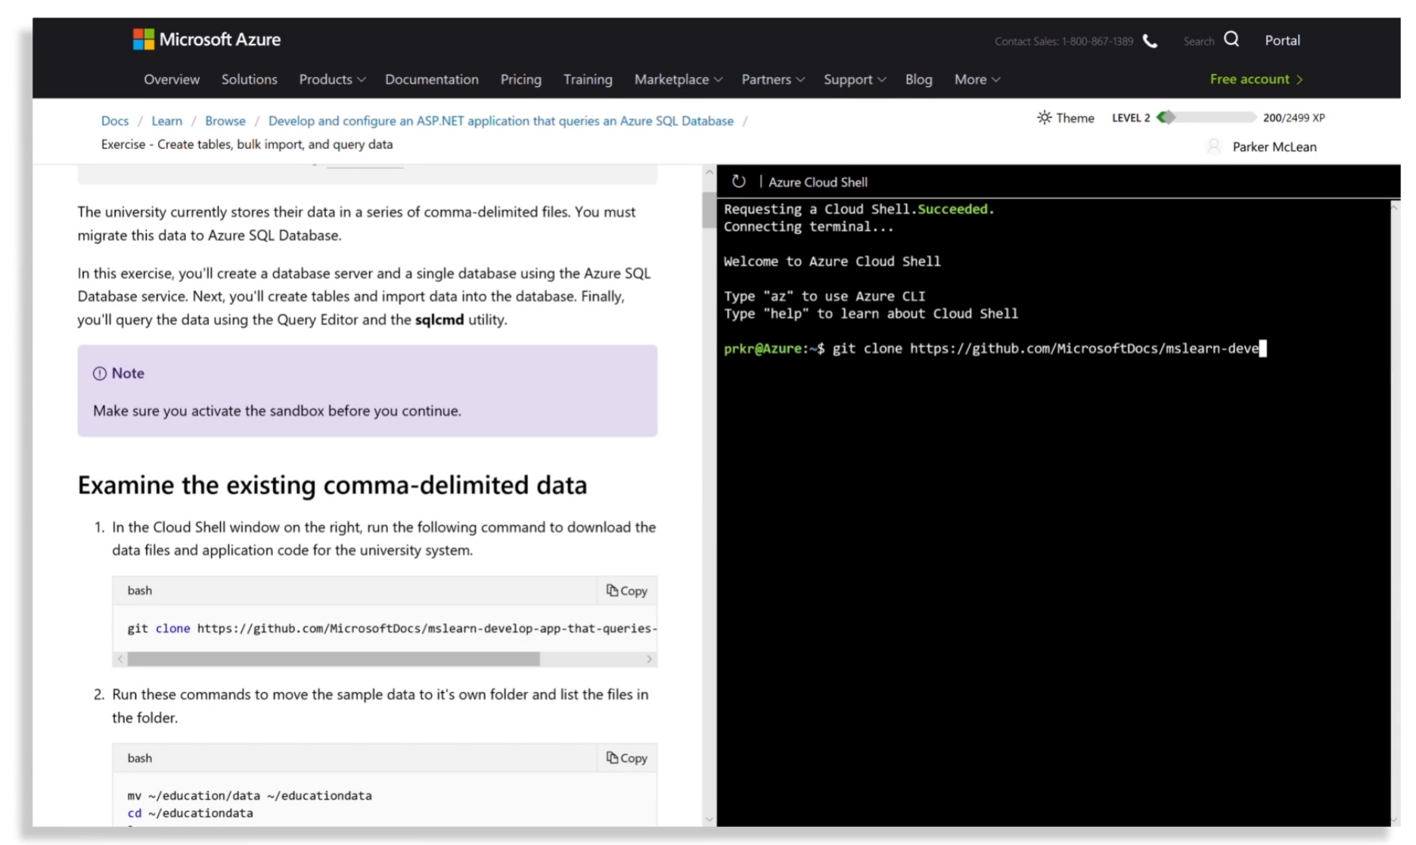
Microsoft Learn
Notes:
And a lot of these Learn Modules provide you with the opportunity to get hands on practice, they provide you with a sandbox environment that is just like the real thing to try things out like deploying Azure resources, if you mess up its all good

Slide 12
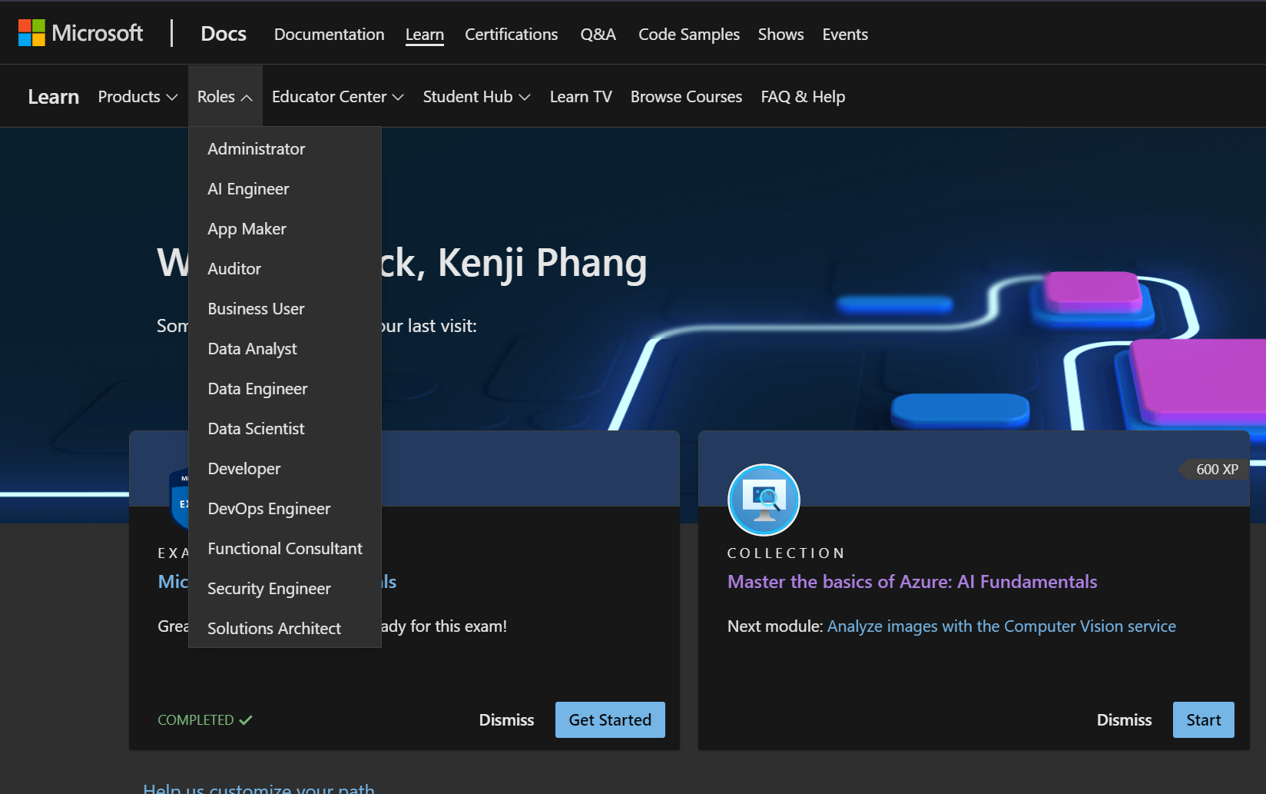
Microsoft Learn
Notes:
The nice thing about Microsoft Learn is that there are role based learning paths for you to follow, as students, we often only know of the umbrella term of a software engineer, but these are all the roles being reflected in the tech industry, so this is a good place for you to explore them.
The learning paths are also marked with different difficulties, if you just want to try out a certain technology, just do the beginner pathways and you should have a good overview. If you are not sure what to specialize in, spend some time looking through the beginner pathways to get a fair comparison, it will save you a lot of time in the future.
Here is another tip, you don’t have to do all the learning directly from Microsoft Learn itself, learning from text can be quite boring, so personally, I watch some videos elsewhere first to get some context on the topic, then I just use Microsoft Learn for what I think its best for, which is the exercises and hands on practice.
https://docs.microsoft.com/en-us/shows/one-dev-minute/what-is-microsoft-learn

Slide 13
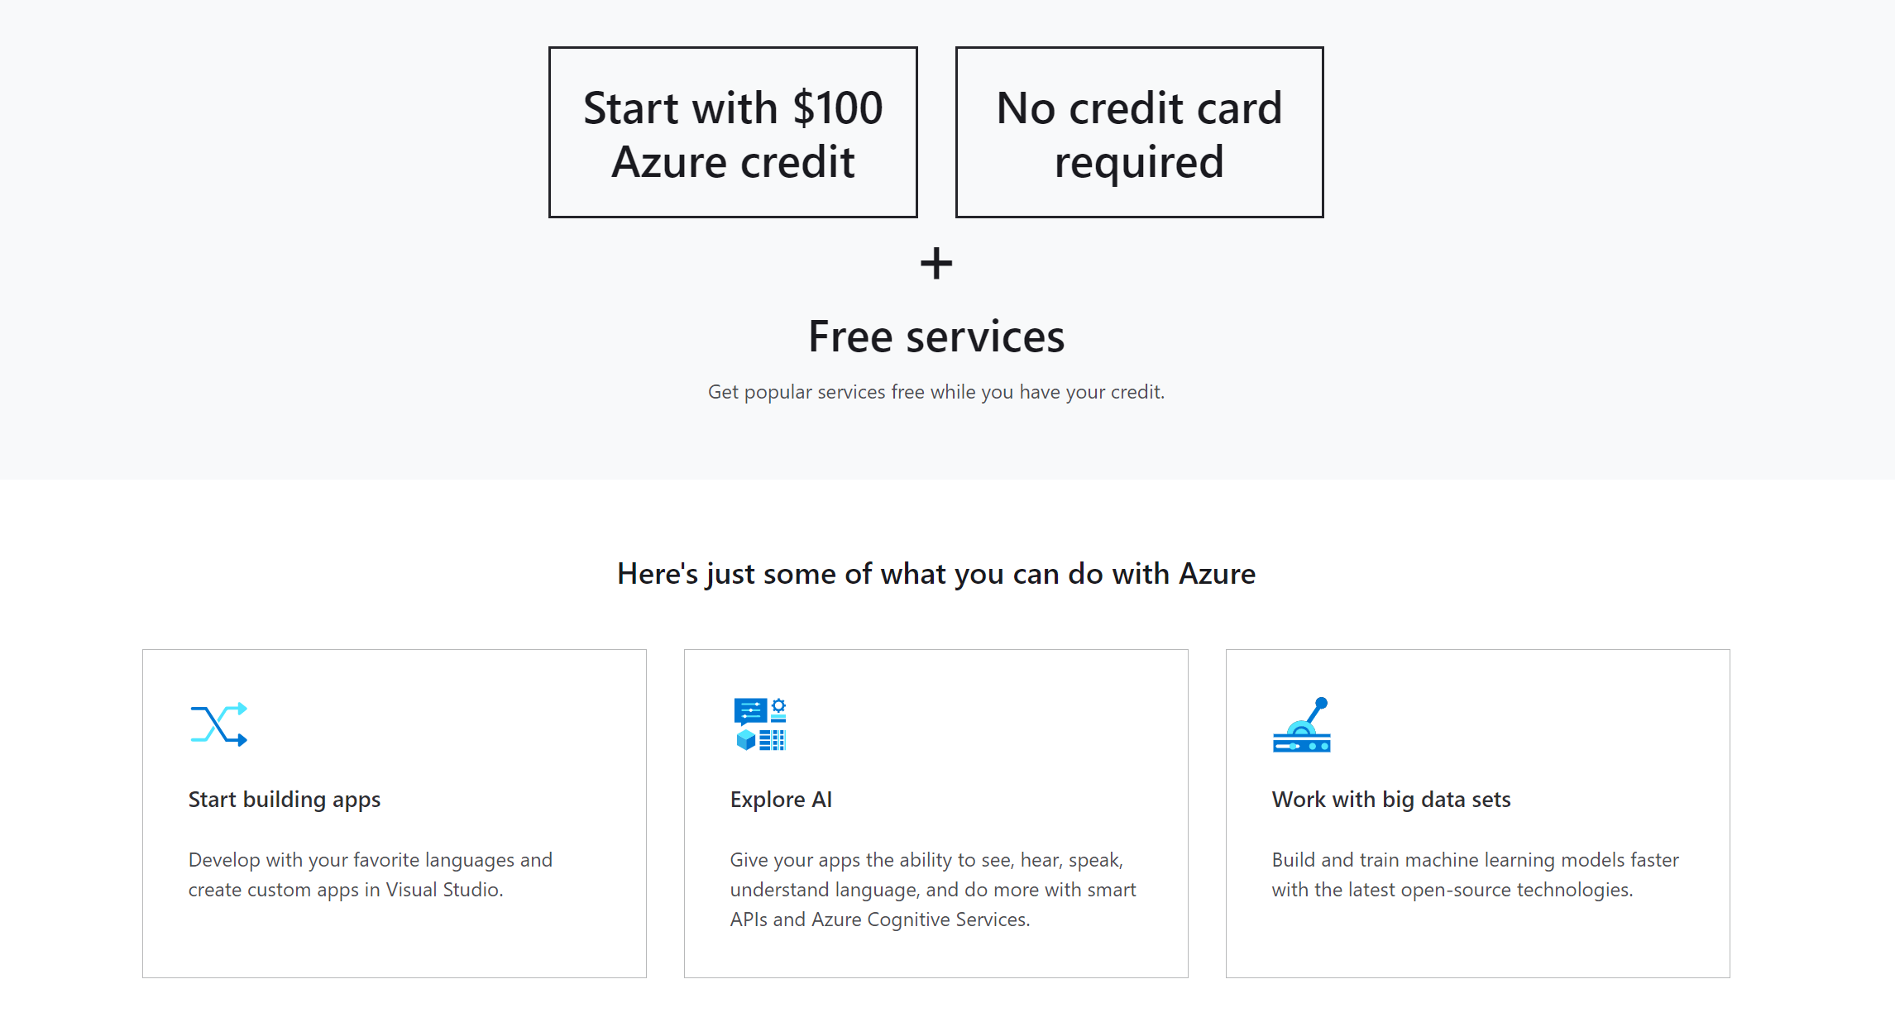
Azure for Students
Notes:
Next up is Azure for Students. Azure is of course Microsoft’s cloud computing platform, and some services do cost money, so Azure for Students is a program where students can get free Azure credits, 100 USD a year and access to free services, and you can renew it every year while you are still a student
Now, you might ask, how should I use the credits or the free services?
After learning the contents from the Learn modules, try to build projects like a portfolio website, a blog site or go wild and make a web service, through Azure for students, you essentially get a place to host stuff for almost free, and deploying something really makes you stand out a lot more

Slide 14

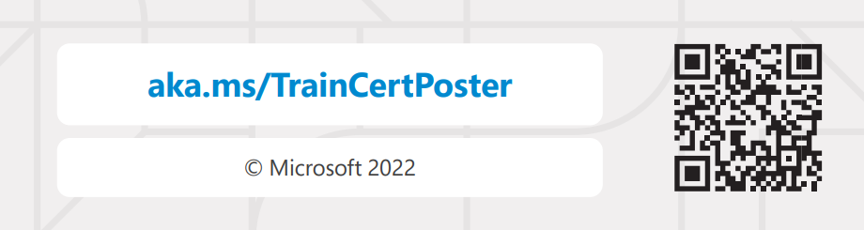
Microsoft Exams for Students
Notes:
To make yourself stand out even more, lets look at the Microsoft Exams. This is a good way to prove that you really have the skills and knowledge. The exams are split into different difficulties, they are role based as well and go hand in hand with the Learn modules, so if you want to take your skills to the next level, just take the exams, Microsoft once did a survey and they found out that you are 2.4x more likely to be approached through Linkedin if you have one of these certs in your profile, that shows how much its worth
https://docs.microsoft.com/en-us/learn/student-hub/certifications

Slide 15
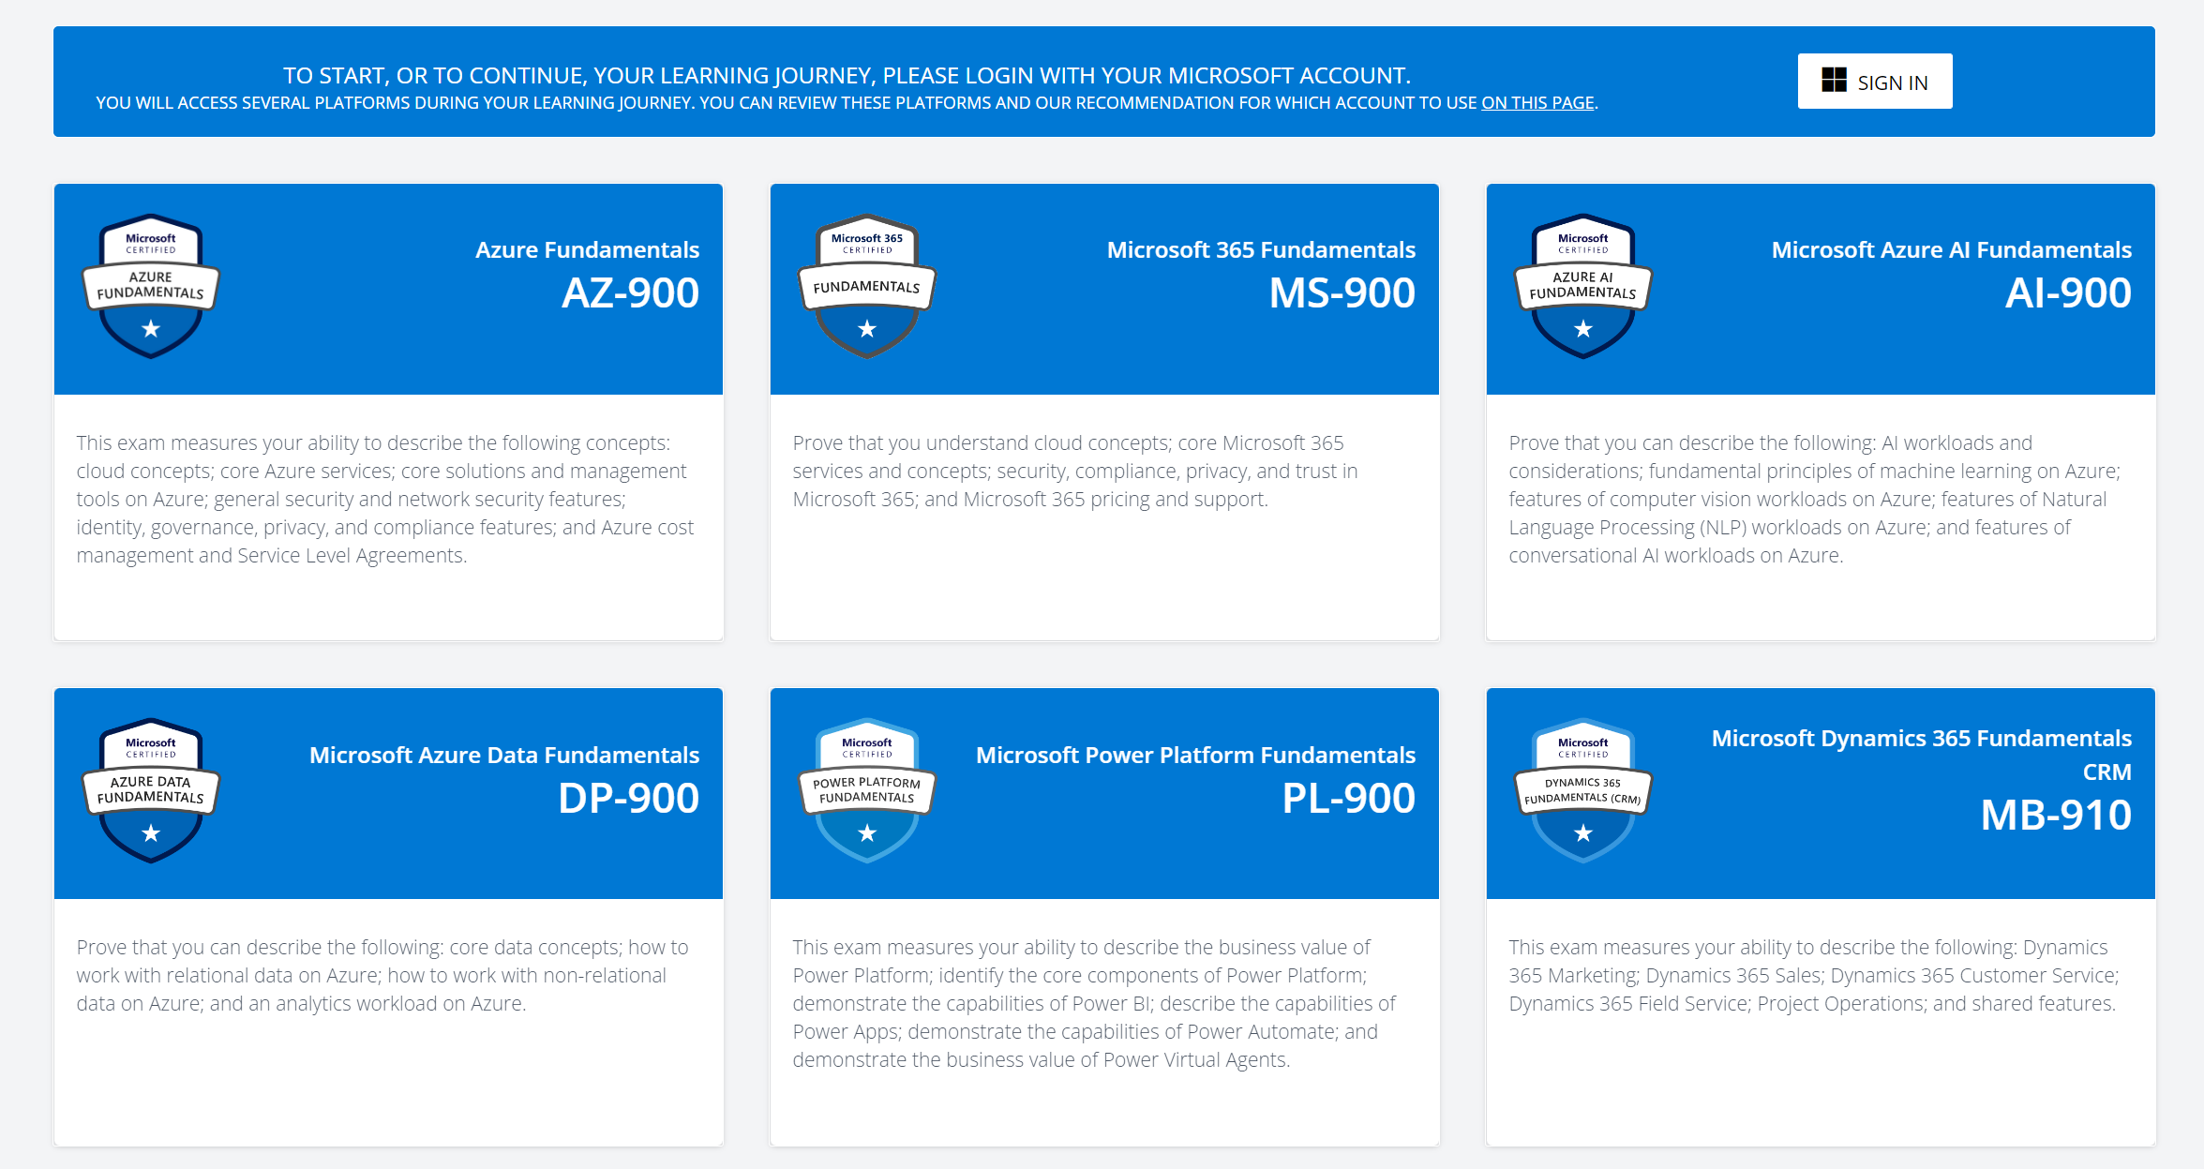
Microsoft Exams for Students
Notes:
The good news here is that all the fundamental exams are currently free for students. You can prepare for the exam through doing the Learn modules, you practice tests for free, and the exams also for free, you are essentially provided with everything you need to pass, so all that’s left to do is to sit the exams. I recommend you all to try out all the fundamental exams, on top of getting the recognition, this is a good way of getting that breadth through the tech industry, so its like killing two birds with one stone.
https://docs.microsoft.com/en-us/learn/student-hub/certifications

Slide 16
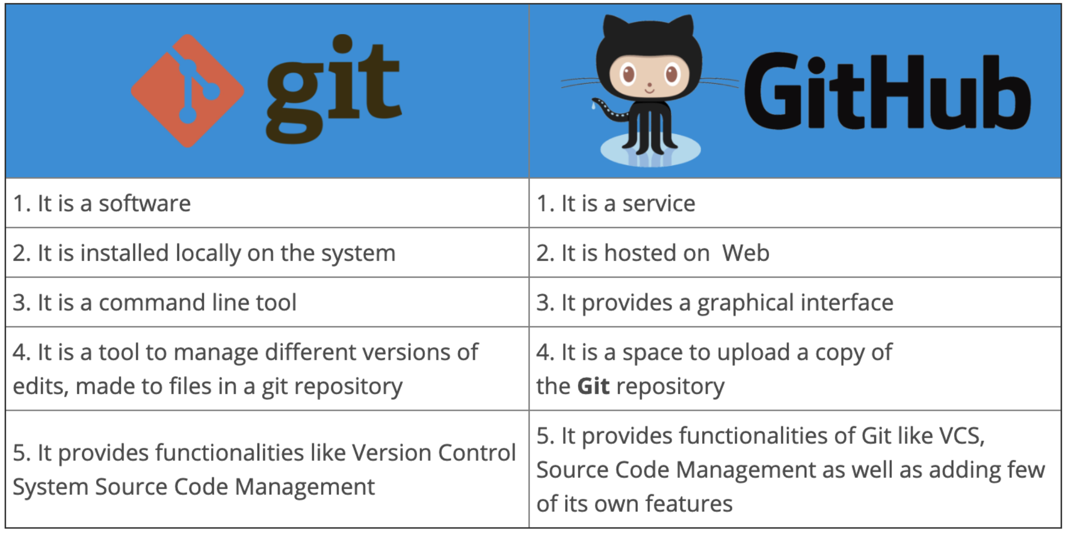
GitHub
Notes:
Onto the next item, Git and GitHub. If you’re confused with them, Git is a source control tool, it lets you collaborate with others, your source code is stored in a remote server and multiple software engineers can then apply changes at the same time. Whereas GitHub is a service provider, they are the ones who host the servers for your repositories
If you don’t have a GitHub account yet, please create one asap. This is where the code for your projects will live, it is essentially your portfolio, it allows you to showcase your work instead of just writing them down in your CV
Git is also one of the most important skills you will need in a workplace, so please master it as soon as possible, I have seen a lot of people being afraid to merge their code or push changes because they are afraid that they might mess things up, and they waste time waiting for someone else to do if for them.

Slide 17
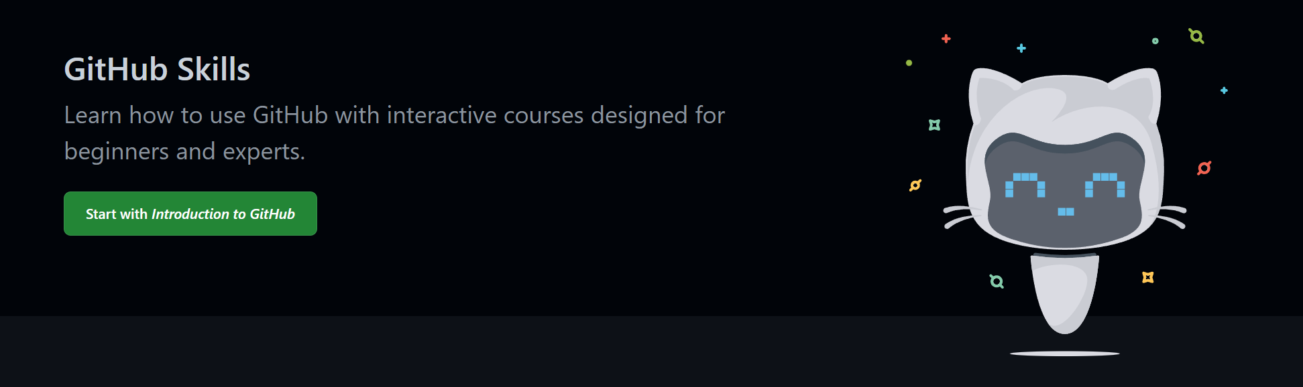
GitHub Skills
Notes:
Conveniently, GitHub has its own learning platform called GitHub Skills. From here, learn the basics git commands, how to use branches and how to merge and rebase them, the different type of workflows, and GitHub actions.
https://skills.github.com/

Slide 18
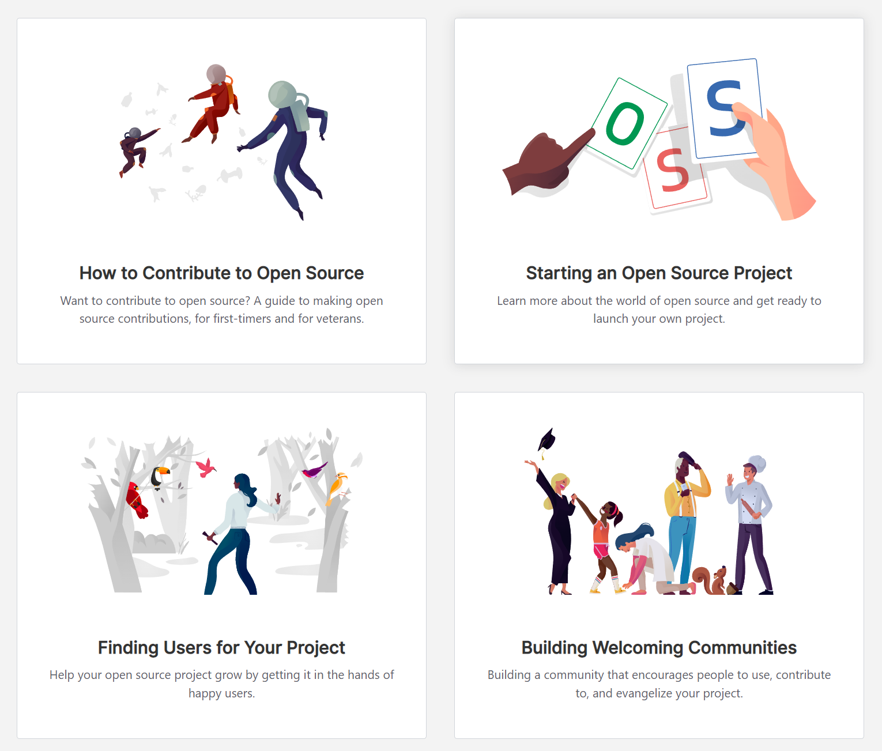
GitHub and Open Source
Notes:
Also, open source is a very popular thing to know now so learn how open source works on GitHub, how to make a pull request etc
https://opensource.guide/

Slide 19
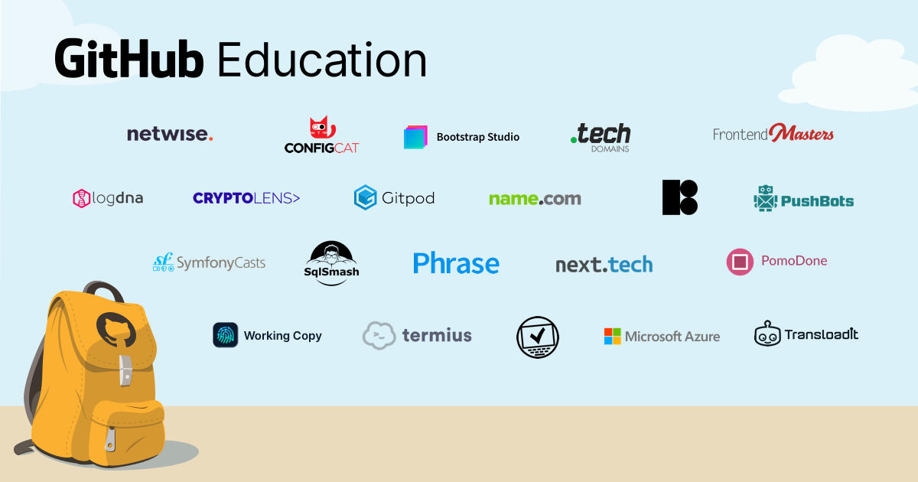
GitHub Education
Notes:
For GitHub student opportunities, we have GitHub education
Get free GitHub Pro
Get the GitHub Student Starter Pack
Connect with GitHub campus experts
https://education.github.com/students

Slide 20
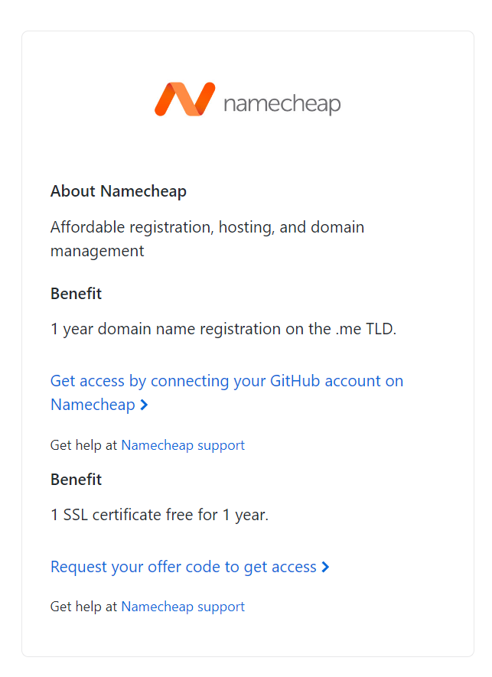
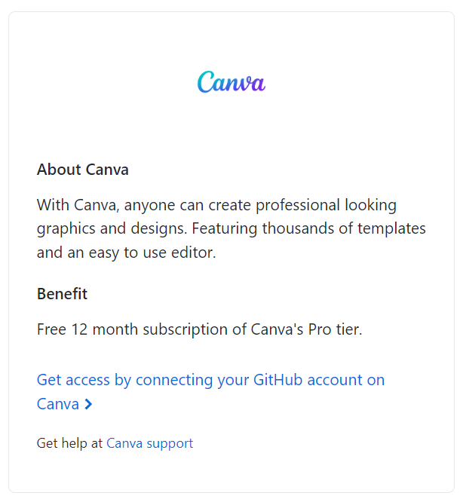
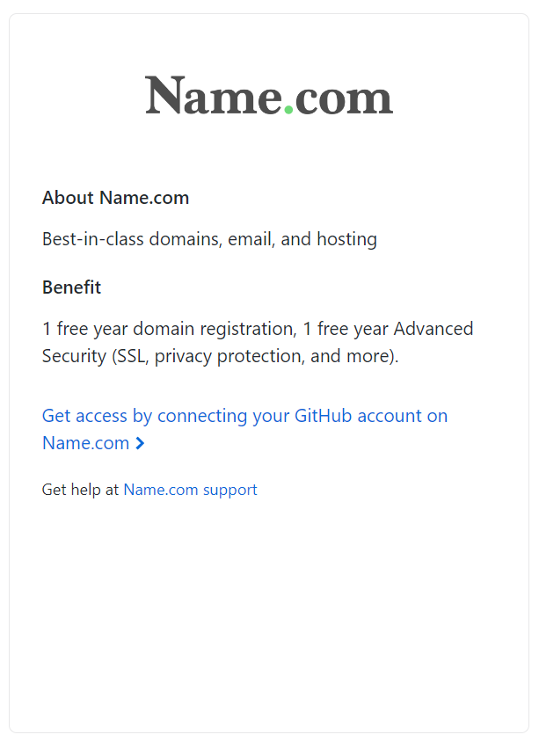
GitHub Student Developer Pack
Notes:
Here is just a bunch of tools that I think are the most useful. Canva, this is a very useful tool for doing any design work, like infomercials and slides, it looks really good.
And more domain names, just more free domain names for your websites.

Slide 21
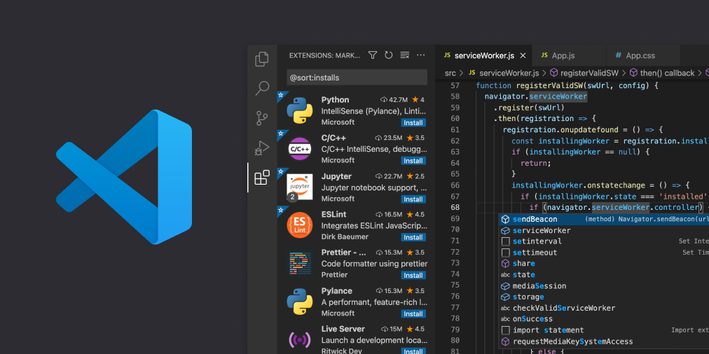
Visual Studio Code
Notes:
Lets move on to the place where you will use to write your code in, Visual Studio Code. Visual Studio Code was originally just a text editor, but it has evolved to become more than just a text editor in the past few years.
Now, you can supercharge your text editor with Extensions, Liveshare collaborations and remote connections. I’ll let Chris explain more about these cool features in the next talk but here are some cool extensions I wanted to share

Slide 22
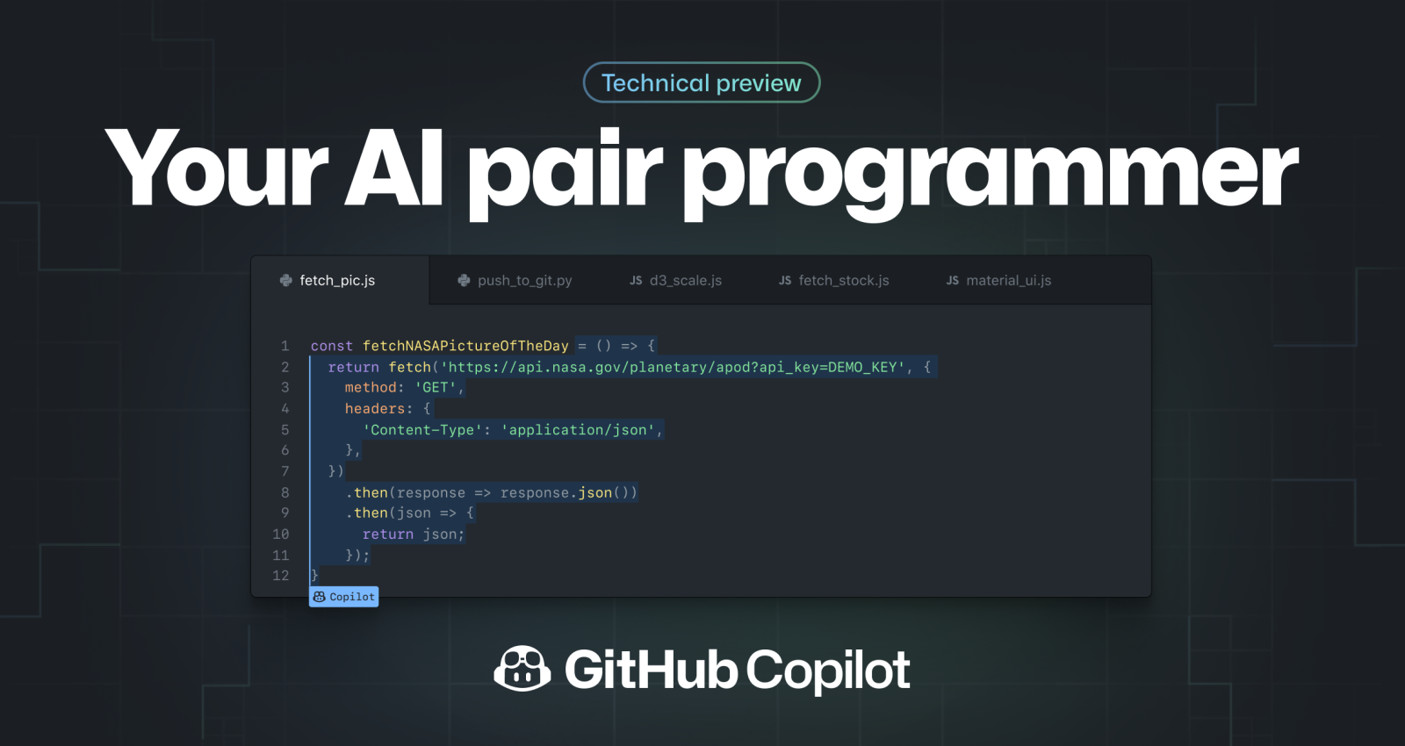
Extension 1: GitHub Copilot
Notes:
GitHub copilot
- An AI that automatically writes code for you based on some simple instructions

Slide 23
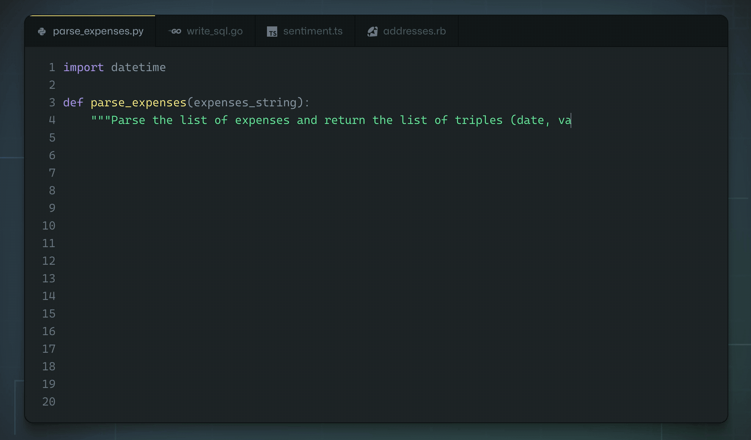
Extension 1: GitHub Copilot
Notes:
Just type in what you want to achieve in the comments and GitHub copilot will generate the text for you

Slide 24
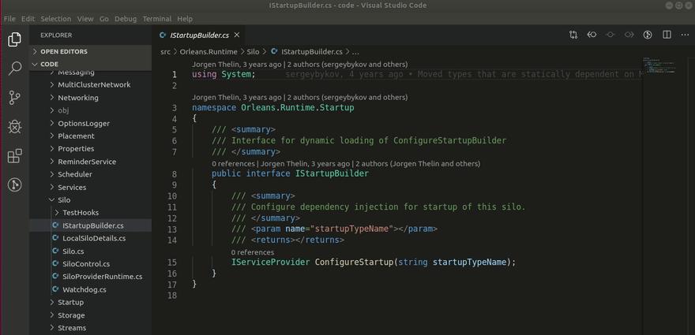
Extension 2: GitLens
Notes:
GitLens
- Easy way to blame people and Interactive rebase

Slide 25
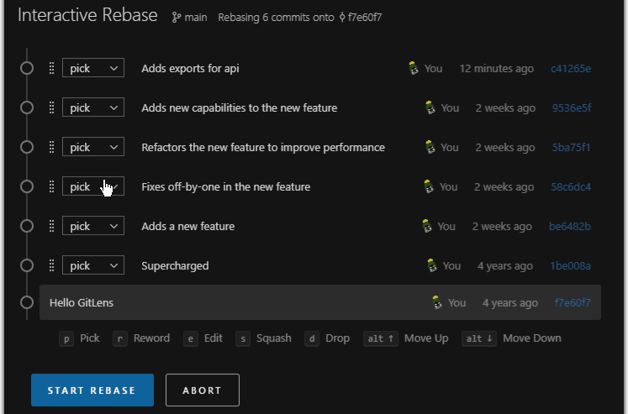
Extension 2: GitLens
Notes:
GitLens
- Easy way to blame people and Interactive rebase

Slide 26


Visual Studio
Notes:
While we are here, I wanted to talk a little about Visual Studio. A lot of people get confused between Visual Studio and Visual Studio Code and I don’t blame them, they are meant to be different but VsCode can now do almost everything, so its getting harder to tell the difference.
But Visual Studio is actually a full IDE for you to write software. We usually use it to write .NET applications, it just has a lot more user friendly controls to maintain and debug large scale software

Slide 27

Linkedin
Notes:
Great, you have all the tools to make you a great developer, now the next step is to let people know you have them, and we do this through LinkedIn
If you don’t have an account yet, make one asap, network with people and share to your them the results of your hard work, post about any career related activities you have recently done, let your network know that you’ve attended the Student Meetup, show that you’re more than just a student
Also, use Linkedin to find out job opportunities or just wait for the recruiters to contact you, if you’ve followed all the steps, people will be approaching you left and right

Slide 28
The other side of the equation
Notes:
If you want to succeed in the world of technology, technical skills can only get you so far. You also need a balance of non-technical skills, like being able to articulate your thoughts and communicate well, teamwork and planning. For example, no matter how good you are at coding, if you are unable to communicate well, its quite hard to even pass the interview round for the job.
So next, we are going to look at some things that can bring your non technical skills up on par with your technical skills

Slide 29
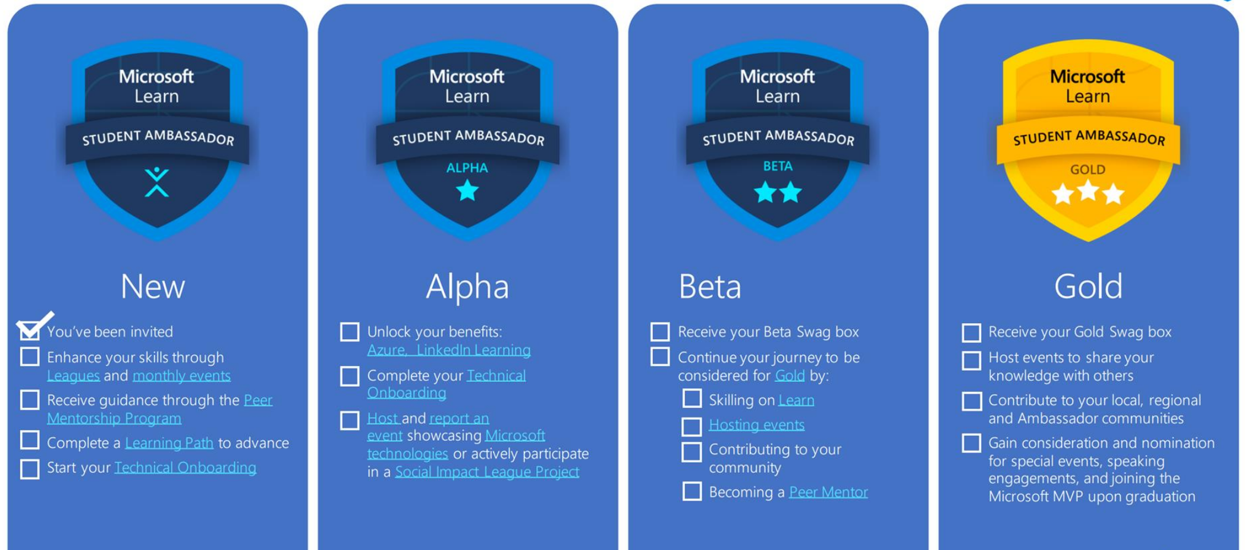
Microsoft Learn Student Ambassadors
Notes:
The first one we will be looking at is the Microsoft Learn Student Ambassadors.
As a Microsoft learn student ambassador, your main responsibility is to run events to share your technical knowledge with other people and build tech communities in your local area. This is your gateway to industry, you will get access to a lot of student opportunities, like recently there was some Windows Insider program and peer mentorship events, you will get to network and collaborate with like minded people through projects and sometimes you can even get cool rewards like LinkedIn Premium or the Xbox game pass.
As you are giving talks, you will naturally become very familiar with the content as you prepare the speech, and you will get the non technical skills like public speaking and keeping calm.

Slide 30


Linkedin Learning
Notes:
Speaking of non technical skills, a great place to learn it is from Linkedin Learning. You normally need to pay quite a sum of money for this service like 30 pounds per month, but you can get it for free through the Microsoft Learn Student Ambassador Program, right after reaching Alpha, which honestly isn’t that hard to reach.
And these Linkedin Learning courses usually come with a certificate which you can add to your profile, so there really is a lot of value

Slide 31
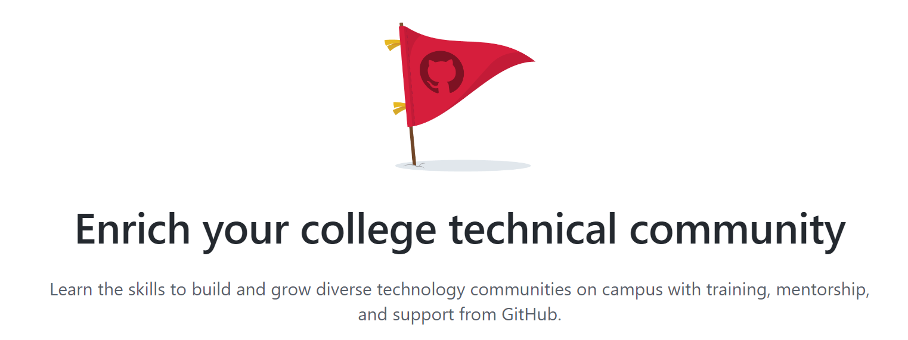
GitHub Campus Experts
Notes:
Another student opportunity you can check out is the GitHub Campus Experts program, this is basically similar with the Microsoft Learn Student Ambassadors program but just for GitHub and it is a little more competitive, they usually only take in one person per campus. But still, its worth applying to get the experience

Slide 32
Going Above and Beyond
Notes:
You’ve now got the technical skills and the non technical skills, now its time to put them to use and go compete for the best idea and innovation

Slide 33

Imagine Cup
Notes:
Introducing the Imagine Cup, it’s Microsoft’s yearly event where students use all their skills to build a solution to a problem and compete with each other to be the very best. This one takes a lot of commitment, the competition lasts a few months and you have to find time to commit as you will need to build a solution and pitch it.
If you are up for a challenge, feel free to apply for it, it definitely is a worthwhile experience, even if you don’t win, you’ve probably be put in a situation to learn a lot within a short amount of time.
That’s it for everything I would like to cover within the pack.

Slide 34




Takeaway
Do something
Learn something
With
Share it
Notes:
What should you takeaway from this talk? Technology is a fast and evolving field, there is always something new everyday. All you need to do is to do this, learn something, doing something with it, use the tools when necessary, share the results on Linkedin, repeat and you will succeed. You have to remember that being good a good developer isn’t a destination, it is a journey. So be ready to learn something new everyday

Slide 35
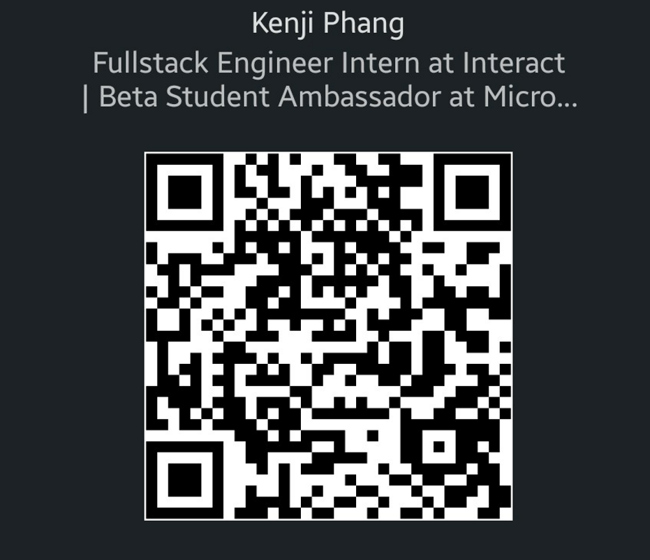
Thanks for listening
LinkedIn
GitHub Repo
Notes:
All right, that’s it from me, I’ve made a GitHub Repo containing the contents of this talk, feel free to share it around. I didn’t have time to include a QnA session so if you all have any questions about any of the tools, the ambassadorship program or anything else, feel free to just ask me, I’ll be at the corner somewhere. Thank you for listening, remember to keep on learning.

